Slide 1
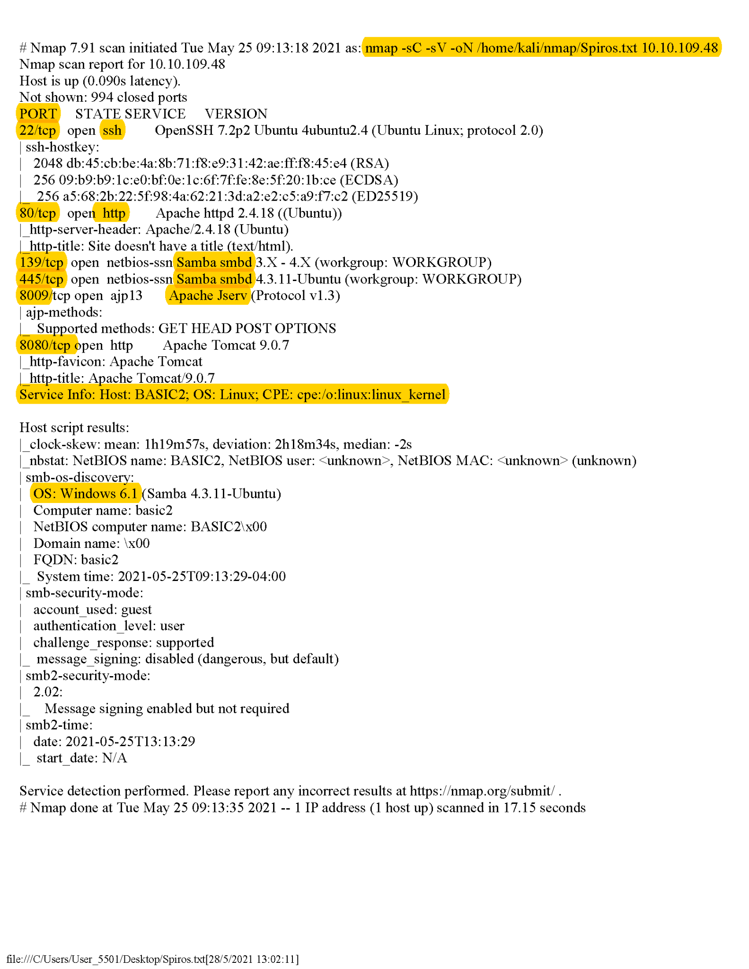

Nmap
A classic reconnaissance tool for host and services discovery.
The majority of the pentesters use it for the very first steps of the process
Example’s commands explained :
nmap -sC --> Performs a script scan using the default set of scripts
nmap -sV --> Probe open ports to determine services
nmap -oN --> extracts the terminal’s result to a grepable form (xml, txt or html)
More about nmap > https://nmap.org/book/man.html
Group 2
Raquel Martinez Diez / Lukasz Kosmaczewski / Vaibhav Chawla
Anagnostopoulos Spiros

Slide 2
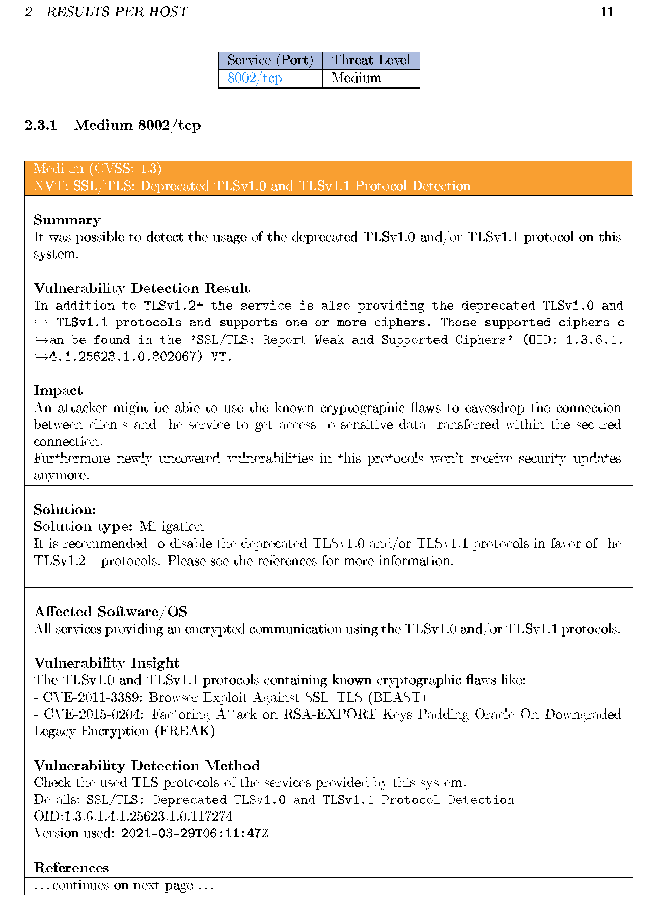

OpenVAS
Is an open source Vulnerability Assessment Scanner
It is not considered an intrusive way of scanning because it doesn’t send malicious payloads that could cause a disruption
Summary and Impact Description
Produces an extended report per host and matches CVE ID for every vulnerability, providing suggestions to mitigate the vulnerability
Further manual testing could focus on points already highlighted by OpenVAS
Group 2
Raquel Martinez Diez / Lukasz Kosmaczewski / Vaibhav Chawla
Anagnostopoulos Spiros

Slide 3
Additional tools we have also take under consideration:
Dirbuster / Gobuster
sqlmap
Command Injection / XML External Entity
DISCLAIMER:
Not sure if this type is allowed because it may be against aws policy
Group 2
Raquel Martinez Diez / Lukasz Kosmaczewski / Vaibhav Chawla
Anagnostopoulos Spiros

Slide 4
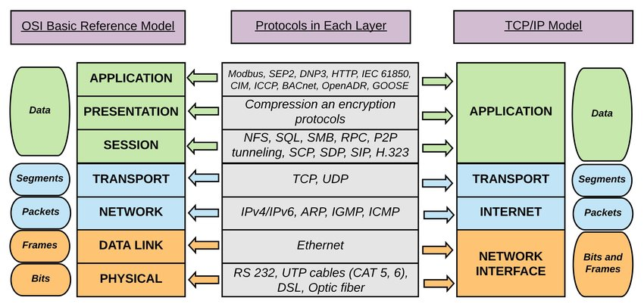
Why does the Internet use TCP/IP and not the OSI stack ?
OSI Model was developed as a theoretical model in an attempt to streamline and define various data networking functions. On the other hand, TCP/IP stack was used by the DoD to implement protocols practically, by adhering the simplicity principle. This required merging/coupling of layers with higher interdependencies, thus decreasing avoidable complexities.
“Increased layering can quickly lead to violation of the Simplicity Principle. Industry experience has taught us that increased layering frequently increases complexity and hence leads to increases in OPEX, as is predicted by the Simplicity Principle” (RFC 3439).
References: https://datatracker.ietf.org/doc/html/rfc3439#section-3

